Slide 1

BST 210 Applied Regression Analysis

Slide 2
Lecture 4 Plan for Today
Notes on Homework
Some questions since last class
Context: Framework for Analyses
Linear Regression: derivations
Evaluating model fit
Residuals: intuition
R², adjusted R², MSE

Slide 3
Notes on Homework
Due via Canvas every Monday (starting 9/23) by 11:59pm.
We encourage you to discuss homework with your fellow students (or with the instructor or the TAs), but you must write your own final answers, in your own words.
Please include the appropriate computer output in your solution if that helps you to answer a question, but be sure to interpret your findings in words – submitting only output is not sufficient for full credit.
Homework assignments will not be accepted late (other than for emergency, but the primary instructor must be reached in advance).
Be complete in your responses, yet not too wordy, to get full scores.
All homework must be submitted online via Canvas.
Notes:
When want to move from t-test, correlation framework to Linear regression?
Confounders, more covariates, more than 1 exposure—complex relationship
T-test in descriptive stats on 1st page manuscript

Slide 4
Questions from/since last class
Outlier deletion
Testing for squared term
Lowess and where there might be knot
’describe output as if for manuscript’
R² > .70 is considered ‘good’
10% rule for confounders
Comparing R² values across models to choose ‘best’ fit
Notes:
When want to move from t-test, correlation framework to Linear regression?
Confounders, more covariates, more than 1 exposure—complex relationship
T-test in descriptive stats on 1st page manuscript

Slide 5
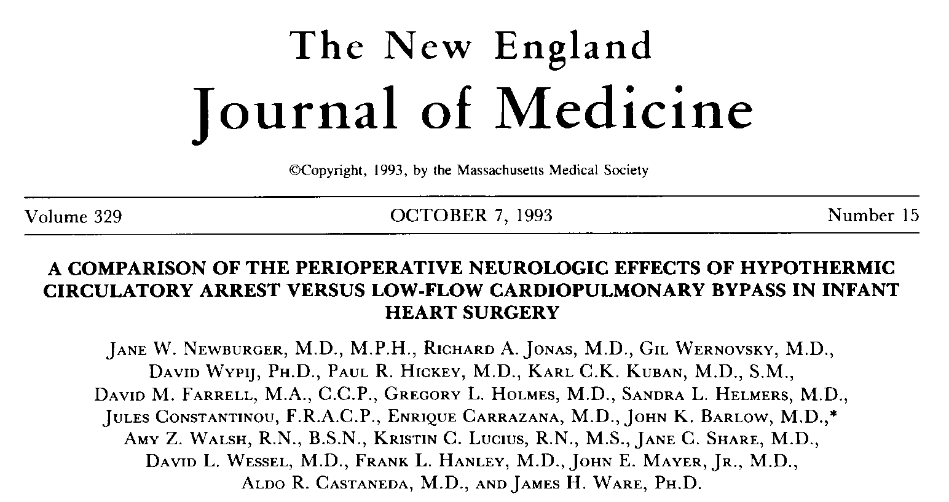

Slide 6
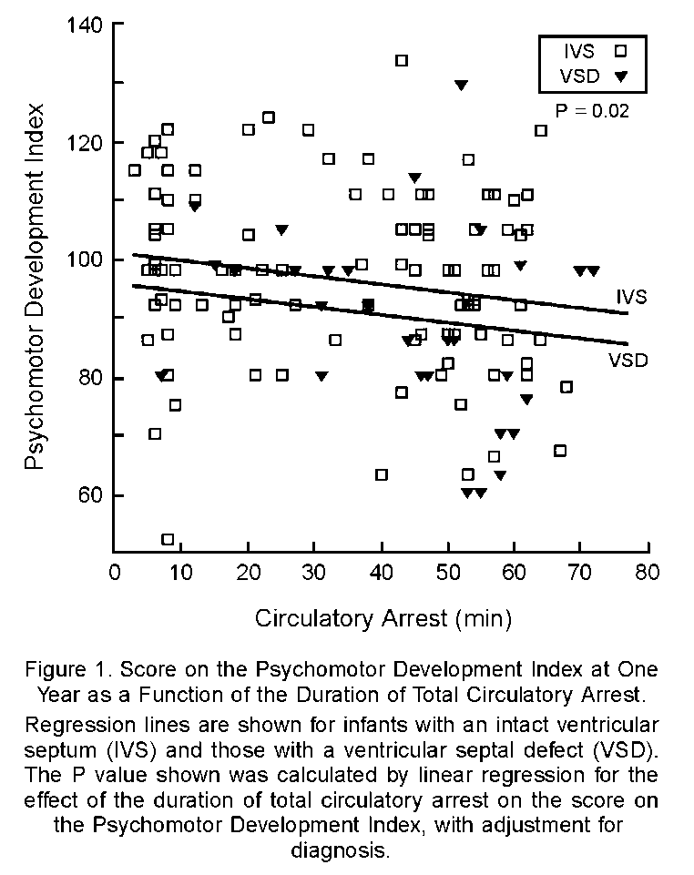
Influence Analysis
Outlying
value?

Slide 7
Questions from/since last class
Outlier deletion
Nonlinear predictor (independent) variables X
Lowess and where there might be knot
’describe output as if for manuscript’
R² > .70 is considered ‘good’
10% rule for confounders
Comparing R² values across models to choose ‘best’ fit
Notes:
When want to move from t-test, correlation framework to Linear regression?
Confounders, more covariates, more than 1 exposure—complex relationship
T-test in descriptive stats on 1st page manuscript

Slide 8
Exploratory ‘smooth’ might not be linear
lowess pdi minutes, xlabel(0(20)120)
ylabel(50(25)150)

Slide 9
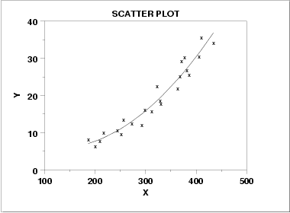
Then what?

Slide 10
Which Linear Model?
E(Y_{i}) = β₀ + β₁·age_{i} + β₂·female_{i}
E(Y_{i}) = β₀ + β₁·age_{i} + β₂·female_{i} + β₃·age_{i}·female_{i}
E(Y_{i}) = β₀ + β₁·age_{i} + β₂·age_{i}²

Slide 11
Questions from/since last class
Outlier deletion
Nonlinear predictor (independent) variables X
Lowess and knots
’describe output as if for manuscript’
R² > .70 is considered ‘good’
10% rule for confounders
Comparing R² values across models to choose ‘best’ fit
Notes:
When want to move from t-test, correlation framework to Linear regression?
Confounders, more covariates, more than 1 exposure—complex relationship
T-test in descriptive stats on 1st page manuscript

Slide 12
‘Knots’ in Smoothing
lowess pdi minutes, xlabel(0(20)120)
ylabel(50(25)150)

Slide 13
Questions from/since last class
Outlier deletion
Nonlinear predictor (independent) variables X
Lowess and knots
10% rule for confounders
’describe output as if for manuscript’
R² > .70 is considered ‘good’
Comparing R² values across models to choose ‘best’ fit
Notes:
When want to move from t-test, correlation framework to Linear regression?
Confounders, more covariates, more than 1 exposure—complex relationship
T-test in descriptive stats on 1st page manuscript

Slide 14
Note on Confounding
If an adjusted analysis gives an appreciably different result than a crude (unadjusted) analysis (rule of thumb: >10%), we say the added variable is a confounder of the exposure-outcome association; use the adjusted analysis!

Slide 15
Recall Confounding
regress pdi minutes
Source | SS df MS Number of obs = 142
-------------+------------------------------ F( 1, 140) = 7.10
Model | 1625.47748 1 1625.47748 Prob > F = 0.0086
Residual | 32033.1422 140 228.808159 R-squared = 0.0483
-------------+------------------------------ Adj R-squared = 0.0415
Total | 33658.6197 141 238.713615 Root MSE = 15.126
------------------------------------------------------------------------------
pdi | Coef. Std. Err. t P>|t| [95% Conf. Interval]
-------------+----------------------------------------------------------------
minutes | -.1545158 .057972 -2.67 0.009 -.2691295 -.0399021
_cons | 100.5708 2.413829 41.66 0.000 95.79857 105.3431

Slide 16
Recall Confounding
regress pdi minutes birthwt
Source | SS df MS Number of obs = 142
-------------+------------------------------ F( 2, 139) = 7.75
Model | 3377.28384 2 1688.64192 Prob > F = 0.0006
Residual | 30281.3359 139 217.851337 R-squared = 0.1003
-------------+------------------------------ Adj R-squared = 0.0874
Total | 33658.6197 141 238.713615 Root MSE = 14.76
------------------------------------------------------------------------------
pdi | Coef. Std. Err. t P>|t| [95% Conf. Interval]
-------------+----------------------------------------------------------------
minutes | -.164923 .0566858 -2.91 0.004 -.277001 -.052845
birthwt | .0084129 .0029668 2.84 0.005 .0025471 .0142788
_cons | 71.20498 10.62018 6.70 0.000 50.207 92.20297
------------------------------------------------------------------------------

Slide 17
Questions since last class
Outlier deletion
Nonlinear predictor (independent) variables X
Lowess and knots
10% rule for confounders
’describe output as if for manuscript’
R² > .70 is considered ‘good’
Comparing R² values across models to choose ‘best’ fit
Notes:
When want to move from t-test, correlation framework to Linear regression?
Confounders, more covariates, more than 1 exposure—complex relationship
T-test in descriptive stats on 1st page manuscript

Slide 18
Interpretation, manuscript style
The slope β_{j} is the change in Y corresponding to a 1 unit change in x_{j}, assuming all other covariates are held constant
We say that we are adjusting for, or controlling for, the other covariates

Slide 19
Interpretation, manuscript style
regress pdi minutes birthwt
Source | SS df MS Number of obs = 142
-------------+------------------------------ F( 2, 139) = 7.75
Model | 3377.28384 2 1688.64192 Prob > F = 0.0006
Residual | 30281.3359 139 217.851337 R-squared = 0.1003
-------------+------------------------------ Adj R-squared = 0.0874
Total | 33658.6197 141 238.713615 Root MSE = 14.76
------------------------------------------------------------------------------
pdi | Coef. Std. Err. t P>|t| [95% Conf. Interval]
-------------+----------------------------------------------------------------
minutes | -.164923 .0566858 -2.91 0.004 -.277001 -.052845
birthwt | .0084129 .0029668 2.84 0.005 .0025471 .0142788
_cons | 71.20498 10.62018 6.70 0.000 50.207 92.20297
------------------------------------------------------------------------------

Slide 20
Results
PDI = 71.2 ̶ 0.165 minutes + 0.0084 birthwt
“For two infants with identical minutes of CA, a birth weight difference of 1000 grams is associated with an 8.4 point total change in predicted PDI score on average, with 95% CI [2.54, 14.28] and P = 0.005.”

Slide 21
Continue to develop general framework for approaching analyses
First -
Learn the topic/study well, really well
Collaborate to define motivating questions of interest, check PubMed, other sources
What techniques might help to achieve answers? Which do the data warrant? (develop intuition, read literature)
Possible Confounding or Effect Modification to account for?
Keep an open mind, and the larger picture – there is no recipe
Notes:
When want to move from t-test, correlation framework to Linear regression?
Confounders, more covariates, more than 1 exposure—complex relationship
T-test in descriptive stats on 1st page manuscript

Slide 22
Continue to develop general framework for approaching analyses
Next -
Diagnostics/Checking Assumptions:
Scatterplot, summary statistics
Boxplots, histograms
Correlations
Smoothing (example: Lowess)
Residual Analysis
Hypothesis testing/modeling:
t-test?
Correlation (r)?
ANOVA useful?
Nonparametric approach better?
Linear regression or extensions (multiple reg.)?
Generalizations
Notes:
When want to move from t-test, correlation framework to Linear regression?
Confounders, more covariates, more than 1 exposure—complex relationship
T-test in descriptive stats on 1st page manuscript

Slide 26
Residual Analysis
To Err is Human,
To Err Randomly is Statistically Divine

Slide 27
Residual Analysis
Residuals (error terms) are the deviations between an observed and predicted Y value:
Plots of residuals can help us to:
detect outliers (observations with very large residuals)
assess normality
assess homoscedasticity (equal variance assumption)
look for nonlinear trends (departures from linearity)
see if other predictor variables may be important

Slide 28
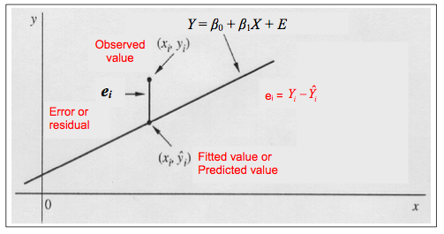
Finding the “Best” Line
Difference between a fitted value and an observed value is called the residual or the “error”
“Best” line is the line that minimizes the error

Slide 29
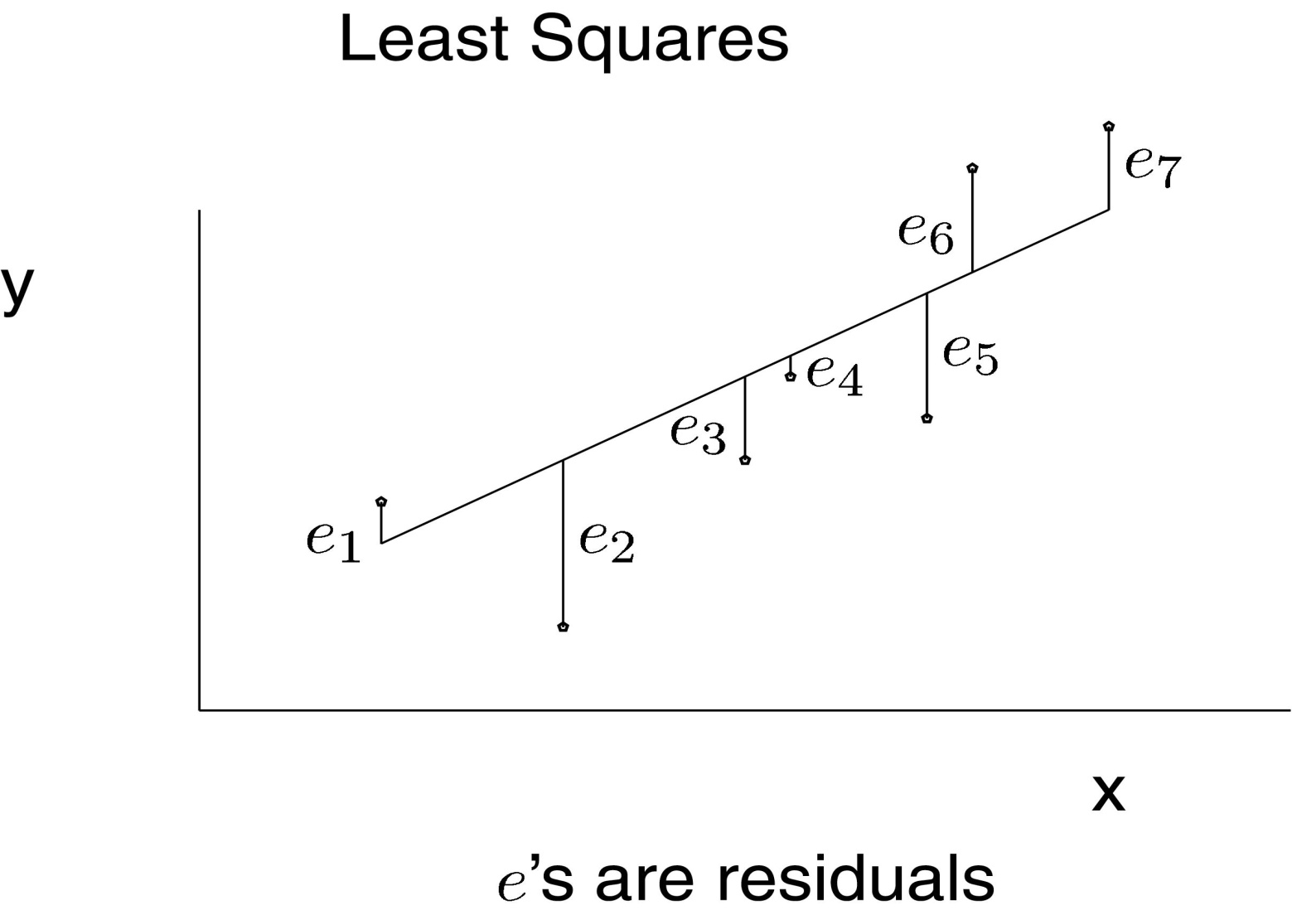
Fitted Line

Slide 30

The least squares line is the line which minimizes the sum of squares of the residuals:

Slide 31



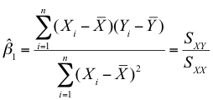
Least Squares Estimation (LSE)
Find a line that minimizes the sums of squares of the errors or residuals
For simple linear regression:
To find (β₀, β₁) that minimizes the SS_{Error} solve:
Then

Slide 32
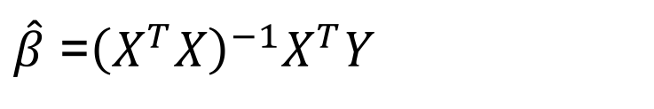

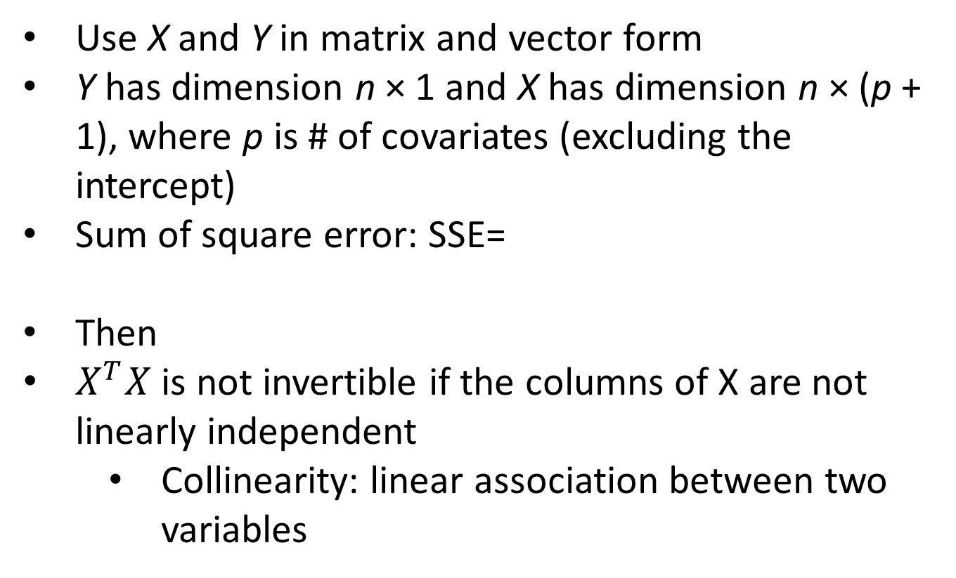
LSE: Multiple Linear Regression
Use X and Y in matrix and vector form
Y has dimension n × 1 and X has dimension n × (p + 1), where p is # of covariates (excluding the intercept)
Sum of square error: SSE=
Then
$X^{T}X$ is not invertible if the columns of X are not linearly independent
Collinearity: linear association between two variables
$${\left(Y−Xβ\right)}^{T}(Y−Xβ)$$
$\hat{β}$ =${\left(X^{T}X\right)}^{−1}X^{T}Y$

Slide 33
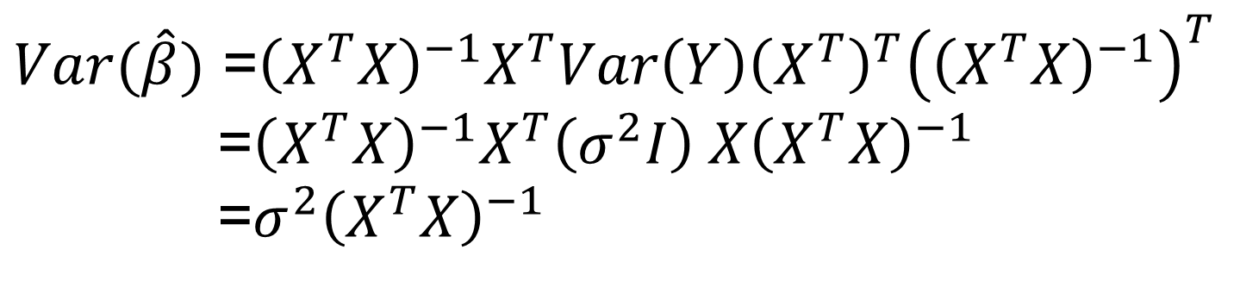
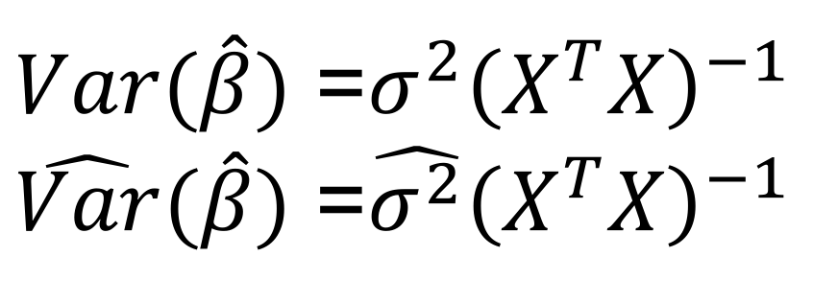
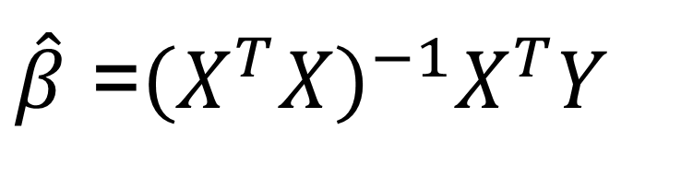
Least Squares Estimation of β (Multiple Linear Regression)
$\hat{β}$ =${\left(X^{T}X\right)}^{−1}X^{T}Y$
$Var(\hat{β})$ =${\left(X^{T}X\right)}^{−1}X^{T}Var\left(Y\right){\left(X^{T}\right)}^{T}{\left({\left(X^{T}X\right)}^{−1}\right)}^{T}$
=${\left(X^{T}X\right)}^{−1}X^{T}\left(σ^{2}I\right) X{\left(X^{T}X\right)}^{−1}$
=$σ^{2}{\left(X^{T}X\right)}^{−1}$
$Var(\hat{β})$ =$σ^{2}{\left(X^{T}X\right)}^{−1}$
$\hat{Var}(\hat{β})$ =$\hat{σ^{2}}{\left(X^{T}X\right)}^{−1}$

Slide 34
Residual Analysis
Assume unobserved true error terms ε_{i}:
Are independent (uncorrelated)
Have a mean of zero
Have a common variance
Follow a normal distribution (required for performing parametric tests of significance and for calculating confidence intervals)
Note that the observed errors e_{i} are not independent random variables (since they must sum to zero)
In general, if the number of residuals (n) is large relative to the number of independent variables (p), the dependency effect can, for all practical purposes, be ignored in any analysis of the residuals.
We can examine the observed residuals (or functions of observed residuals) to assess the appropriateness of the assumptions listed above.

Slide 35
Residual Analysis
In a scatterplot of the residuals vs. the fitted Y values there should be:
Scatter, but no discernible patterns in the residuals (a pattern may suggest a nonlinear trend)
Approximately equal variance (spread) for different values (homoscedasticity)
Hopefully, approximate normality and no far outliers
For simple linear regression, a scatterplot of the residuals vs. X is basically equivalent to a scatterplot of the residuals vs. the fitted Y values (because of the linear model assumption)

Slide 36
Residual Analysis
A histogram of the residuals can be used to visually assess normality (perhaps with an approximating normal plot overlaid)
One could make a Q-Q (quantile-quantile) plot, plotting the quantiles (sorted values) of the residuals vs. the quantiles of the normal distribution – departure from a straight line would provide evidence of non-normality
There are a variety of formal tests for normality (Kolmogorov-Smirnov, Shapiro-Wilks, Anderson-Darling) that could be performed
Not always recommended

Slide 37
Residual Analysis
If outliers occur, first go back and check the original data to be sure there were no errors in data entry.
You may want to fit the model with and without one or a small number of outliers, to see how much the model inferences change due to these outliers.
However, be very careful of reporting results with outliers deleted.
This could make your model look “too good” relative to the original data.
Possibly you would report your inferences both with and without the outliers.
If things don’t change substantially, go with all of the data.

Slide 38
Residual Analysis
In practice, one often finds some evidence for departures from normality
For larger sample sizes, often you would reject normality based on formal testing
Bottom line is that slight departures from normality are usually fine, provided you have a moderate to large sample size

Slide 39
Regression Analysis with residuals
Regression diagnostics are tools that can be used to assess the linearity, homoscedasticity, and normality assumptions of linear regression.
Regression diagnostics are also used to help identify outliers and influential points in a regression model.
With linear models, the assumptions of linearity, homoscedasticity, and normality are so intertwined that they often are met or violated as a set.

Slide 40
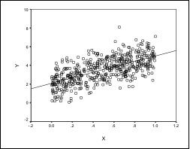
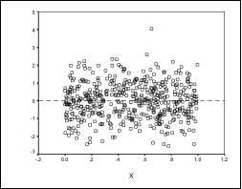
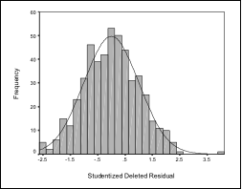
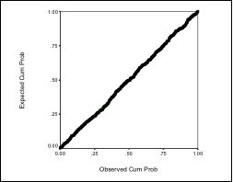
Assumptions Satisfied (Y/N?)
Scatterplot Residual Plot
Histogram Normal Probability Plot

Slide 41
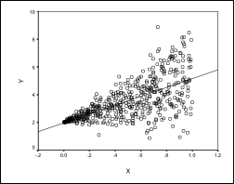
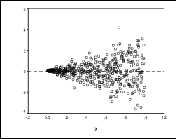
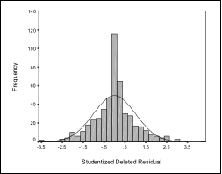
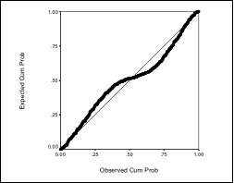
Assumptions Satisfied (Y/N?)
Scatterplot Residual Plot
Histogram Normal Probability Plot

Slide 42
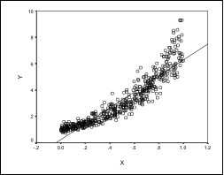
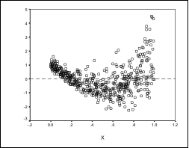
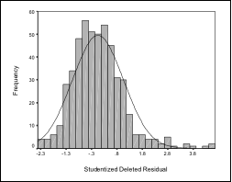
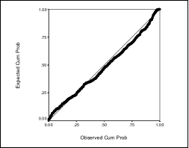
Assumptions Satisfied (Y/N?)
Scatterplot Residual Plot
Histogram Normal Probability Plot

Slide 43
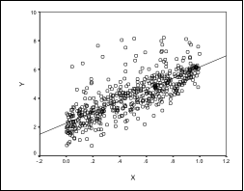
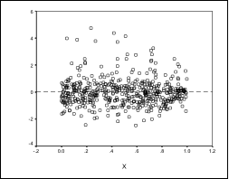
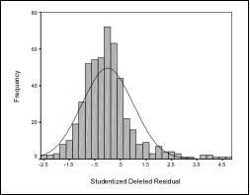
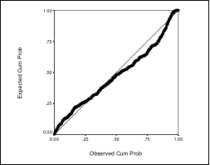
Assumptions Satisfied (Y/N?)
Scatterplot Residual Plot
Histogram Normal Probability Plot

Slide 44
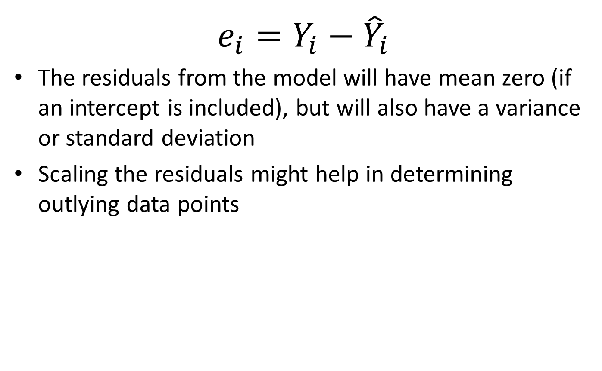
Scaling Residuals
$$e_{i}=Y_{i}−{\hat{Y}}_{i}$$
The residuals from the model will have mean zero (if an intercept is included), but will also have a variance or standard deviation
Scaling the residuals might help in determining outlying data points

Slide 45
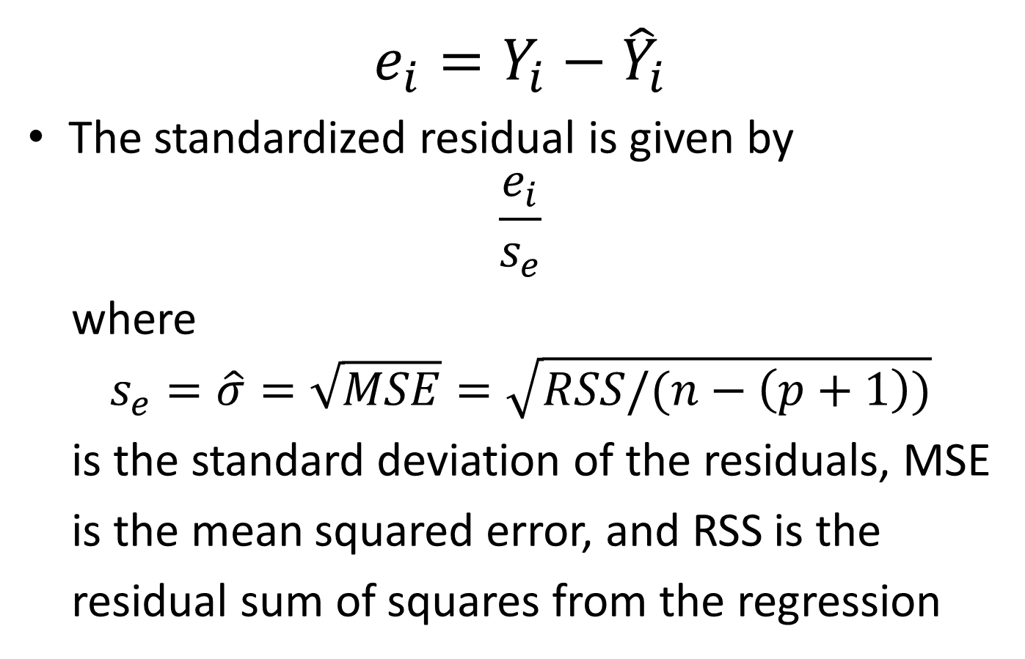
Standardized Residuals
$$e_{i}=Y_{i}−{\hat{Y}}_{i}$$
The standardized residual is given by
$$\frac{e_{i}}{s_{e}}$$
where
$$s_{e}=\hat{σ}=\sqrt{MSE}=\sqrt{RSS/(n−\left(p+1\right))}$$
is the standard deviation of the residuals, MSE
is the mean squared error, and RSS is the
residual sum of squares from the regression

Slide 46
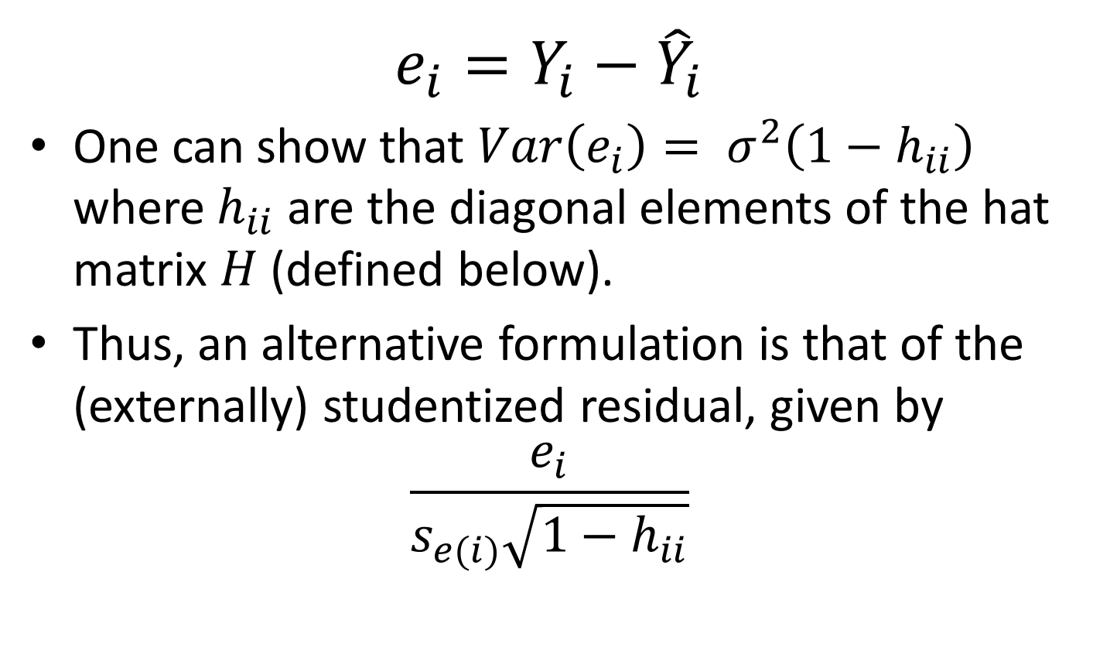
Studentized Residuals
$$e_{i}=Y_{i}−{\hat{Y}}_{i}$$
One can show that $Var\left(e_{i}\right)= σ^{2}\left(1−h_{ii}\right)$ where $h_{ii}$ are the diagonal elements of the hat matrix $H$ (defined below).
Thus, an alternative formulation is that of the (externally) studentized residual, given by
$$\frac{e_{i}}{s_{e(i)}\sqrt{1−h_{ii}}}$$

Slide 47
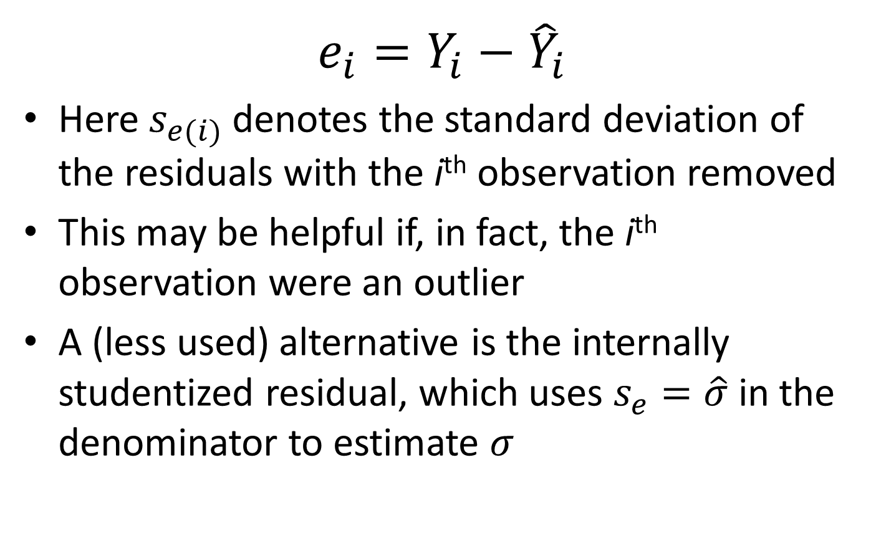
Studentized Residuals
$$e_{i}=Y_{i}−{\hat{Y}}_{i}$$
Here $s_{e(i)}$ denotes the standard deviation of the residuals with the i^{th} observation removed
This may be helpful if, in fact, the i^{th} observation were an outlier
A (less used) alternative is the internally studentized residual, which uses $s_{e}=\hat{σ}$ in the denominator to estimate $σ$

Slide 48
Scaling Residuals
The nice thing about the standardized residuals is that they have mean zero and standard deviation one
Another nice thing about the studentized residuals is that they are less effected by an outlier
Often they are pretty close together

Slide 49
Scaling Residuals
It may be easier to compare the standardized (or studentized) residuals to standard normal cutoffs to look for outlying observations, e.g., >2 (or >1.96) in absolute value
One could compare models run including and then excluding points with high standardized or studentized residuals

Slide 50
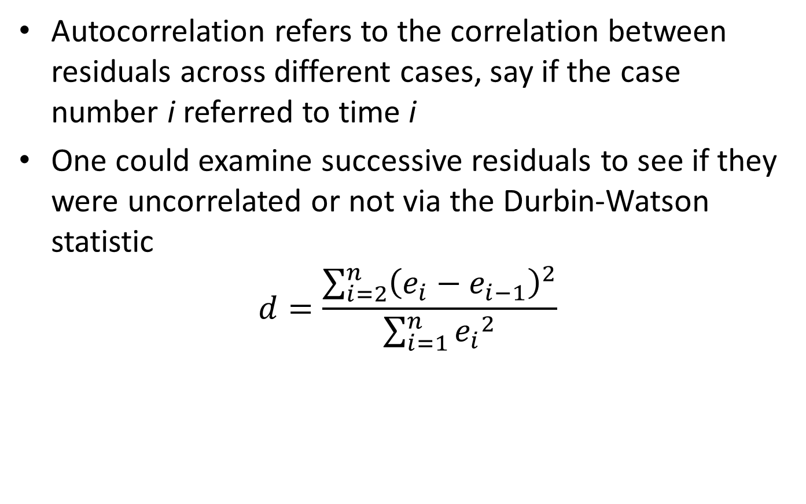
Autocorrelation in Residuals
Autocorrelation refers to the correlation between residuals across different cases, say if the case number i referred to time i
One could examine successive residuals to see if they were uncorrelated or not via the Durbin-Watson statistic
$$d=\frac{\sum_{i=2}^{n}{{\left(e_{i}−e_{i−1}\right)}^{2}}}{\sum_{i=1}^{n}{{e_{i}}^{2}}}$$

Slide 51
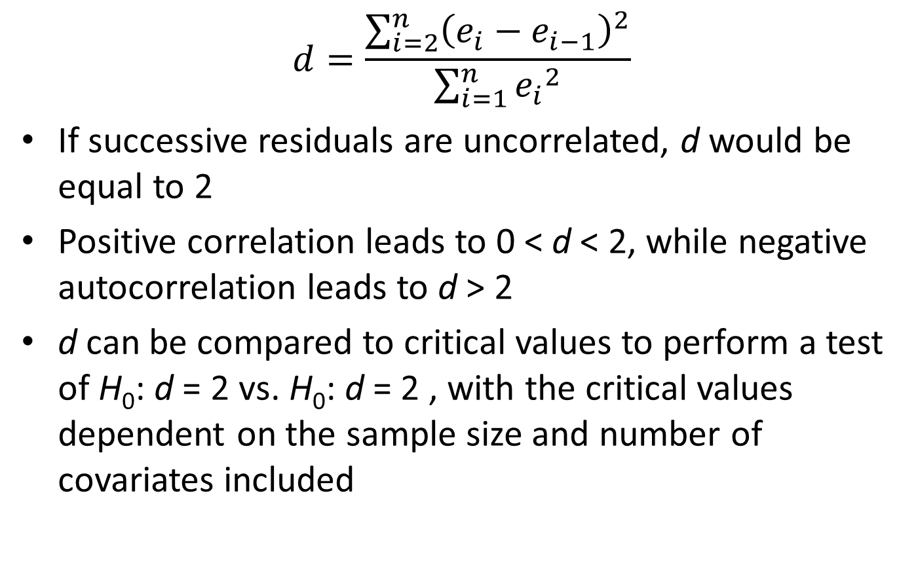
Autocorrelation in Residuals
$$d=\frac{\sum_{i=2}^{n}{{\left(e_{i}−e_{i−1}\right)}^{2}}}{\sum_{i=1}^{n}{{e_{i}}^{2}}}$$
If successive residuals are uncorrelated, d would be equal to 2
Positive correlation leads to 0 < d < 2, while negative autocorrelation leads to d > 2
d can be compared to critical values to perform a test of H₀: d = 2 vs. H₀: d = 2 , with the critical values dependent on the sample size and number of covariates included

Slide 52
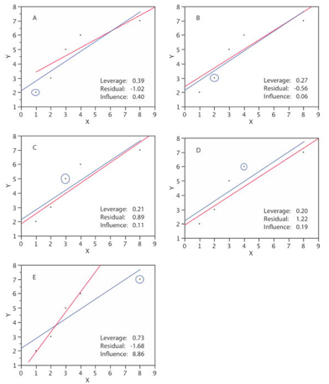
Influence Analysis
An observation is influential if its deletion substantially changes the regression results
High leverage => potential influence
In simple linear regression, a scatterplot would usually identify influential observations, but this is more difficult in multiple linear regression
It could be a particular combination of the covariates and outcomes that leads to an influential observation

Slide 53
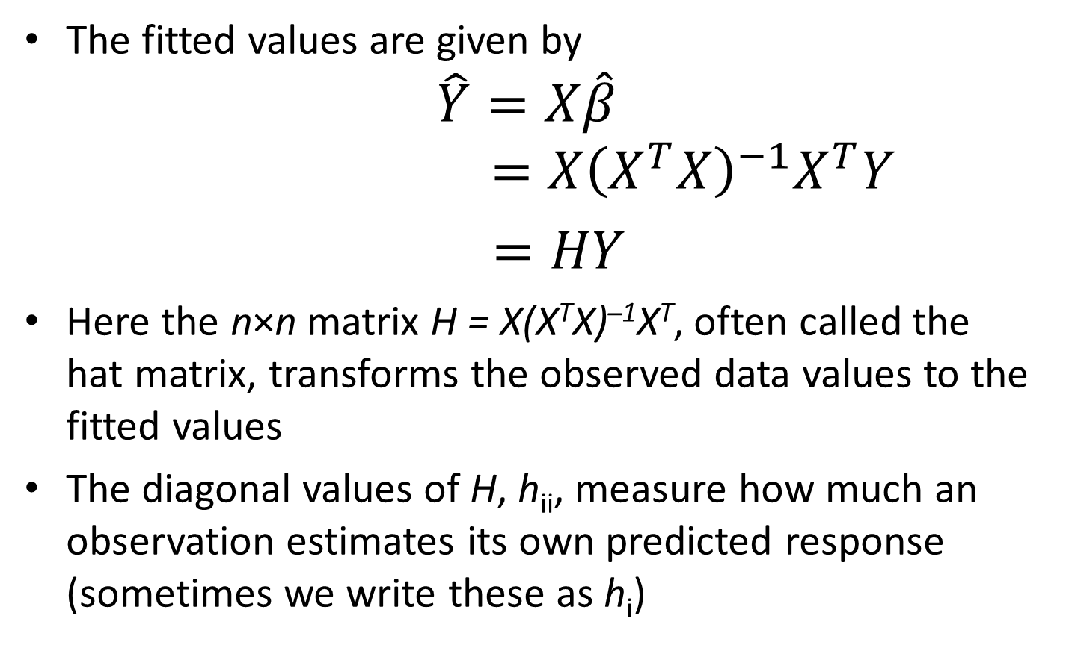
Influence Analysis: Leverage
The fitted values are given by
$$\hat{Y}=X\hat{β}$$
$$=X{\left(X^{T}X\right)}^{−1}X^{T}Y$$
$=HY$
Here the n×n matrix H = X(X^{T}X) ^{̶ 1}X^{T}, often called the hat matrix, transforms the observed data values to the fitted values
The diagonal values of H, h_{ii}, measure how much an observation estimates its own predicted response (sometimes we write these as h_{i})

Slide 54
Influence Analysis: Leverage
One could use boxplots or histograms to assess for observations with high h_{ii} values (these are called high leverage observations)
One can show that the average of the n h_{ii} values is (p + 1)/n, where p is the number of covariates (excluding the intercept) and n is the number of observations
One rule of thumb is that h_{ii} > 2(p + 1)/n signals a high leverage point (more than twice the average value)

Slide 55
Influence Analysis: Leverage
Others have proposed guidelines that say if the maximum value of h_{ii} is ≤ 0.2 you are safe, if 0.2 < max(h_{ii}) ≤ 0.5 it is risky, and to try to avoid max(h_{ii}) > 0.5 if at all possible
The intuition is that as h_{ii} approaches 1, the i^{th} case almost completely controls the regression
One could compare models run including and then excluding high leverage points

Slide 56
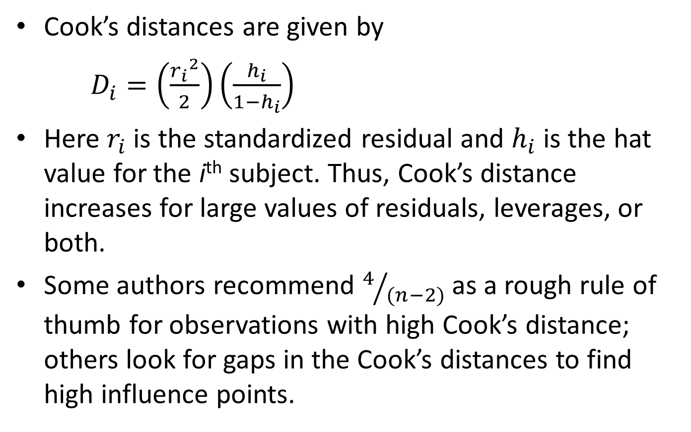
Influence Analysis: Cook’s Distance
Cook’s distances are given by
$D_{i}=\left(\frac{{r_{i}}^{2}}{2}\right)\left(\frac{h_{i}}{1−h_{i}}\right)$
Here $r_{i}$ is the standardized residual and $h_{i}$ is the hat value for the i^{th} subject. Thus, Cook’s distance increases for large values of residuals, leverages, or both.
Some authors recommend $4/{(n−2)}$ as a rough rule of thumb for observations with high Cook’s distance; others look for gaps in the Cook’s distances to find high influence points.

Slide 57
Influence Analysis: DFBETA
The DFBETA statistic quantifies how much each of the regression coefficients would change if each observation were omitted from the data set
DFBETA_{ik} assesses how much the k^{th} regression coefficient, β_{k}, changes (in standard error units) if the i^{th} observation is deleted
The formula for DFBETA_{ik} is not that important, but making boxplots or histograms of the statistics could be helpful in determining influential observations

Slide 58
Influence Analysis: DFBETA
Because of the scaling of DFBETA_{ik}, a rule of thumb is that |DFBETA_{ik}| > 2/sqrt(n) should detect roughly the top 5% of influential cases
One could compare models run including and then excluding points with high DFBETA_{ik} values

Slide 59
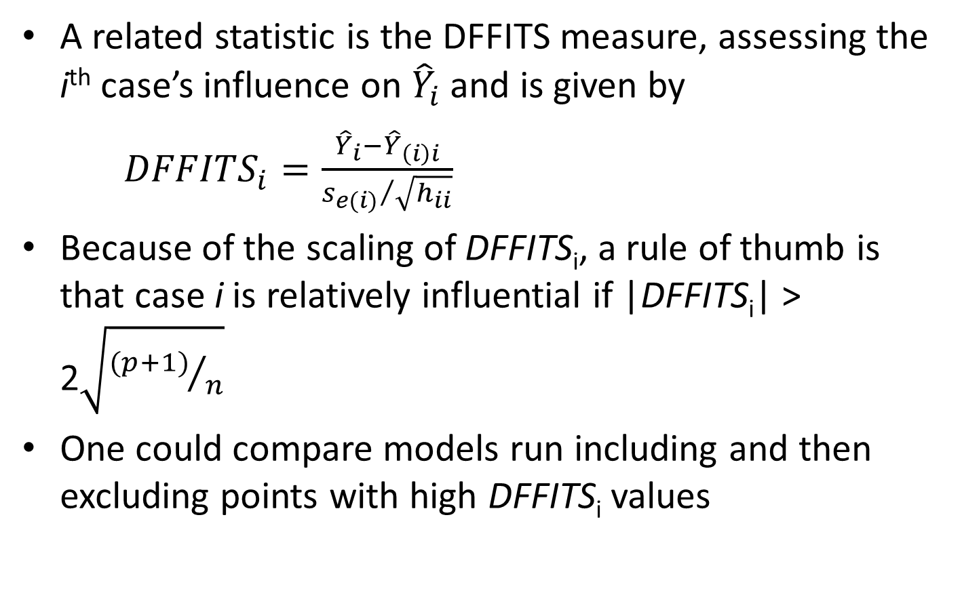
Influence Analysis: DFFITS
A related statistic is the DFFITS measure, assessing the i^{th} case’s influence on ${\hat{Y}}_{i}$ and is given by
${DFFITS}_{i}=\frac{{\hat{Y}}_{i}−{\hat{Y}}_{\left(i\right)i}}{{s_{e(i)}}/{\sqrt{h_{ii}}}}$
Because of the scaling of DFFITS_{i}, a rule of thumb is that case i is relatively influential if |DFFITS_{i}| > 2$\sqrt{{(p+1)}/n}$
One could compare models run including and then excluding points with high DFFITS_{i} values

